Slide 1
Analysis of the factors affecting students’ participation when engaging with optional online teaching and learning activities
Karen Dinneen & Pascaline Fresneau
Dublin Dental University Hospital
School of Dental Science

Slide 2
Introduction
Dublin Dental University Hospital - School of Dental Science
National Dental Nurse Training Programme of Ireland - Diploma in Dental Nursing
Image from http://www.dentalhospital.ie/about-us

Slide 3
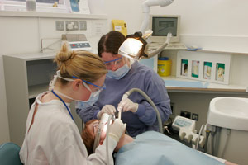
National Dental Nurse Training Programme of Ireland
16 month part-time programme
Trainee dental nurses in dental surgeries
The Dental Team

Slide 4
National Dental Nurse Training Programme of Ireland
Utilising Online Learning Technologies
Videoconferencing

Slide 5
Our project
Increasing student online engagement and socialisation by:
Creating additional online teaching and learning activities using gamification pedagogy
Creating an online reward system (badges) for the successful completion of online activities
Analysing student engagement with these online teaching and learning activities and online reward system

Slide 6
Progress to date
On Blackboard
Additional discussion forums
Study aids
Treasure hunts
Quick quizzes for self-assessment
Online reward system (badges)
On Blackboard Collaborate
Group work

Slide 7
Quick Quiz

Slide 8
Badges

Slide 9
Online group work

Slide 10
Project sustainability
Further development of online teaching & learning activities
Development of online reward system (badges)
Continual monitoring of student engagement
Analysis of impact of online teaching & learning activities and online reward system over the next 3 academic years (until July 2019)

Slide 11
Opportunities for other areas in College
Template for other Schools of the Faculty to increase online engagement
Gamification
Badgification

Slide 12
Questions?
karen.dinneen@dental.tcd.ie
pascaline.fresneau@dental.tcd.ie
Dublin Dental University Hospital
Image from http://en.hdyo.org/tee/questions

